Slide 1
PyTorch and GAN
Charlie Lu

Slide 2
What is PyTorch
Why PyTorch
Automatic differentiation engine
Ndarray library with GPU support
Gradient based optimization package
Utilities (data loading, etc.)
Python-first philosophy
Tape-based autograd system (reverse-mode automatic differentiation)
Decipherable stack traces. Easy to debug.
Easily extend the Python ecosystem (numpy, scipy, Cython)

Slide 3
Dynamically Compiled Graph (DCG)
Debugging made easy.
print(foo)
PBD to set breakpoints
No obscure error message hidden behind abstractions
Identify bottlenecks with your favorite Python profiler such as SnakeViz
More flexible architectures
No compilation time (All core kernels pre-compiled)
Linear style of programing (Chainer, Dynet, TF-eager)
JIT compilation to fuse and optimize operations in graph
Lazy evaluation (cache subgraphs)
Graph compiled every iteration (Can implement some crazy/stupid research ideas easily e.g. random number of layers in hidden cells every every batch)

Slide 4


PyTorch
TensorFlow
Pro
Dynamic Graph
Easy to Debug
Pythonic
Numpy integration
Pro
Keras
TensorBoard
Tensorflow Serving
Con
No mobile support
Only Unix support for now
Not as good for distributed yet
Con
Static Graph
Hard to debug
Slow

Slide 5
How to install?
conda install pytorch torchvision cuda80 -c soumith
Packaged with Cuda, Cudnn, NCCL already

Slide 6
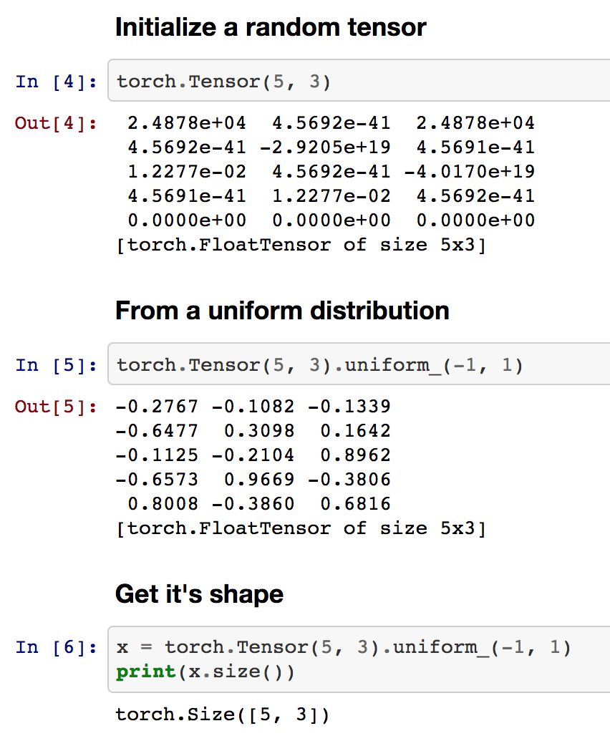
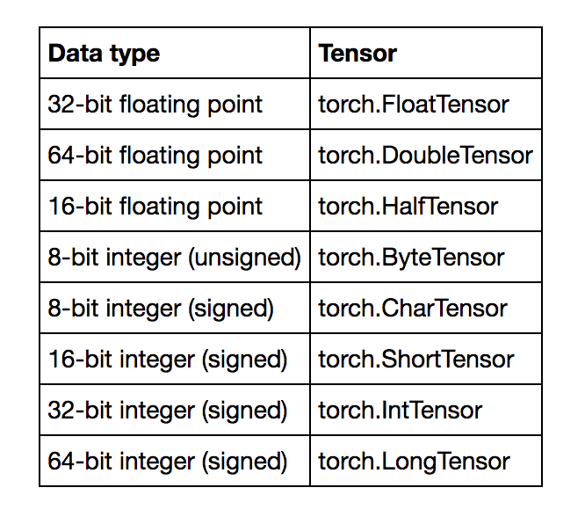
Tensors

Slide 7
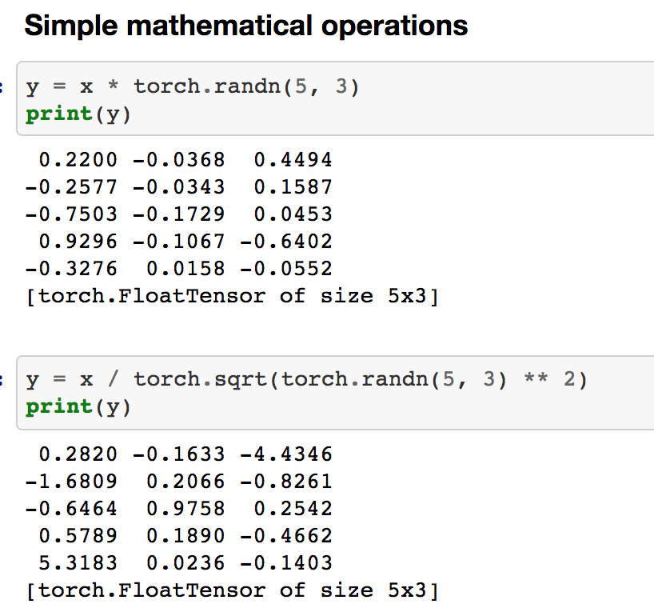
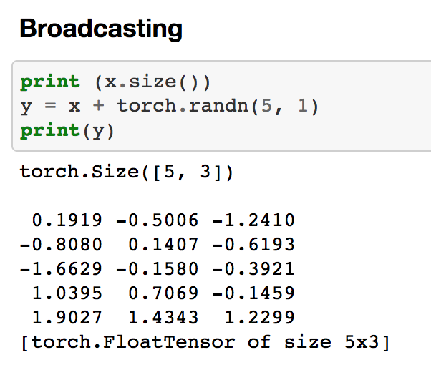

Slide 8
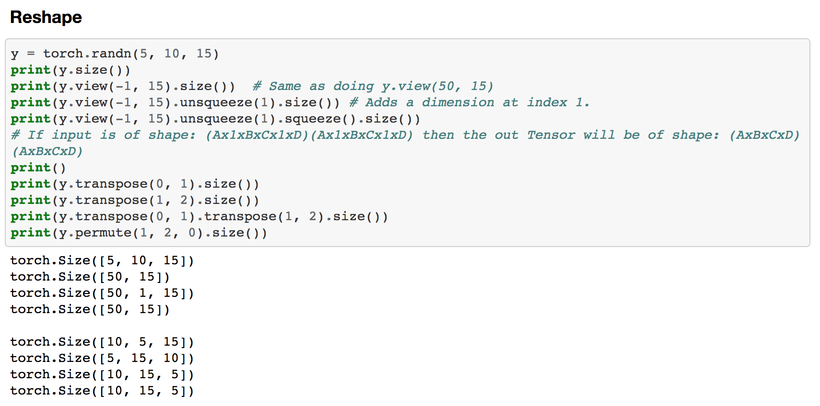

Slide 9
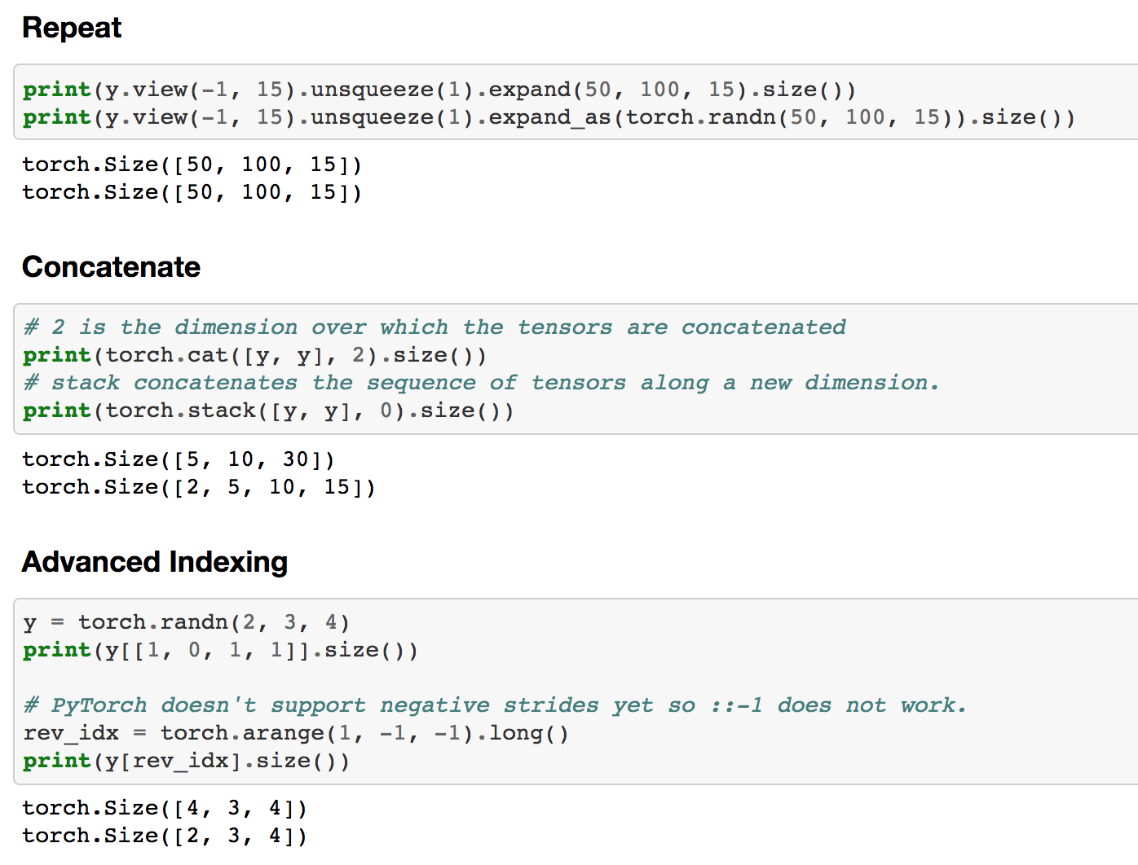

Slide 10
Numpy Bridge
import numpy as np
A = torch.ones(3, 2)
B = A.numpy()
C = np.random.randn(2, 3)
A @ B
_.shape # (3, 3)
import torch
A = np.ones(3, 2)
B = torch.from_numpy(A)
C = torch.randn(2, 3)
A @ B
_.size() # (3, 3)

Slide 11
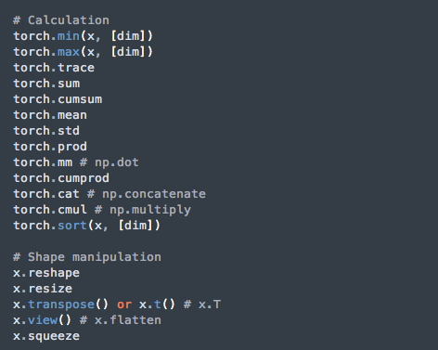
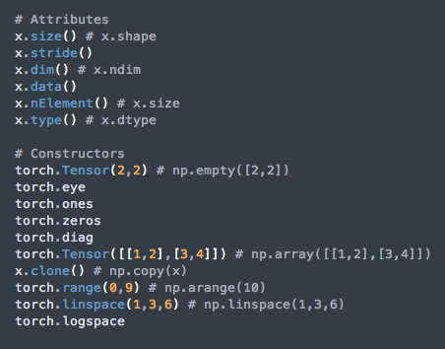

Tensor methods (Numpy in comments when different) `

Slide 12
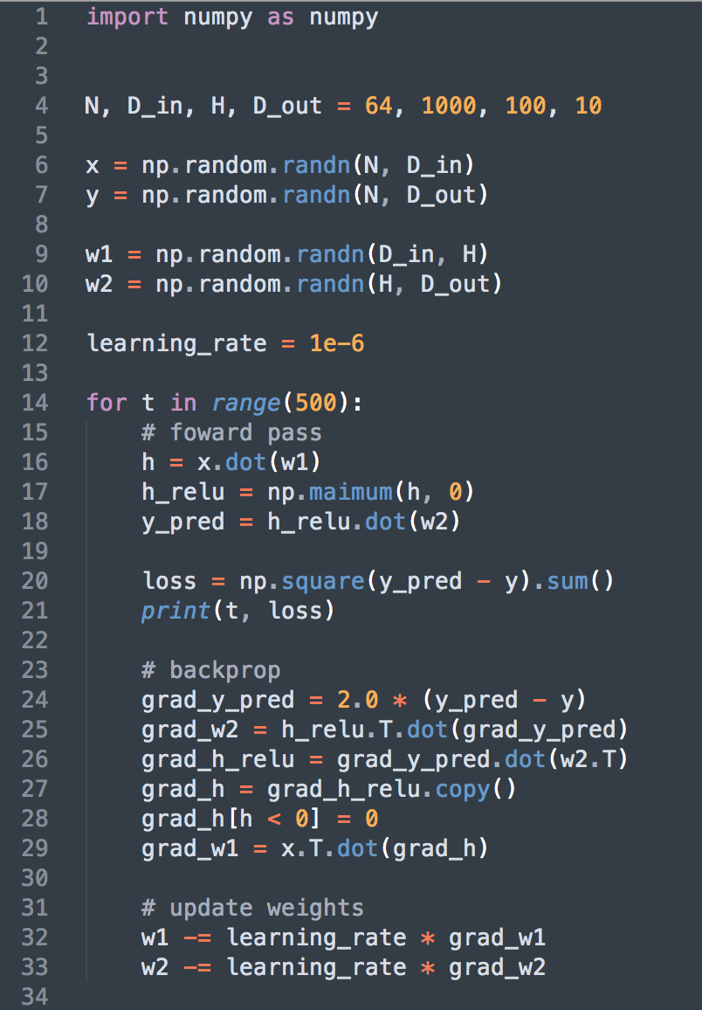
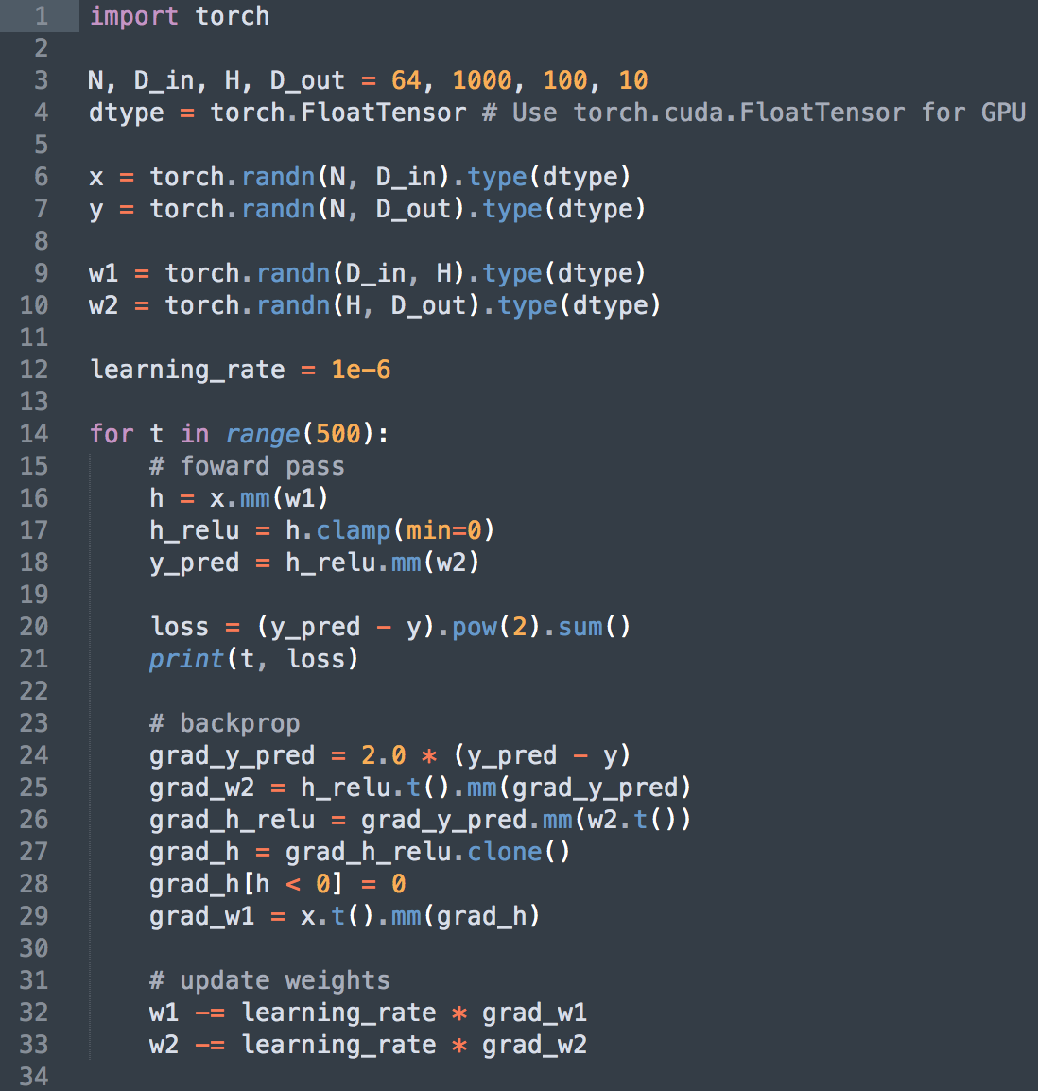

Slide 13
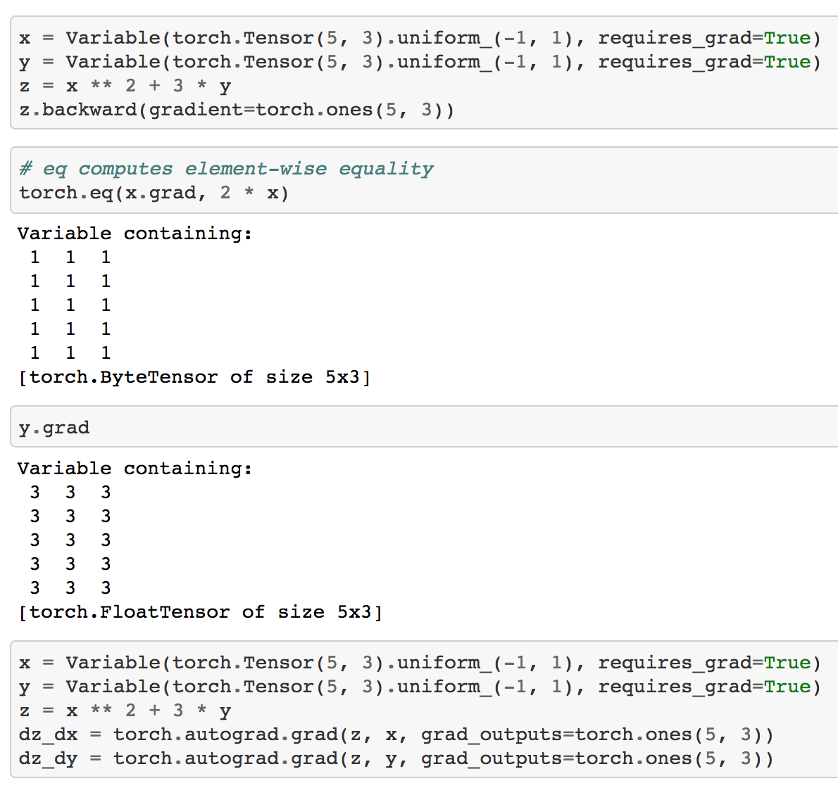
Variables
Use to wrap a tensor and records operations applied to it
Usually for differentiation
Gradient of the loss w.r.t. this variable is accumulated into .grad
Tell variable to needs to store gradient with requires_grad=True

Slide 14
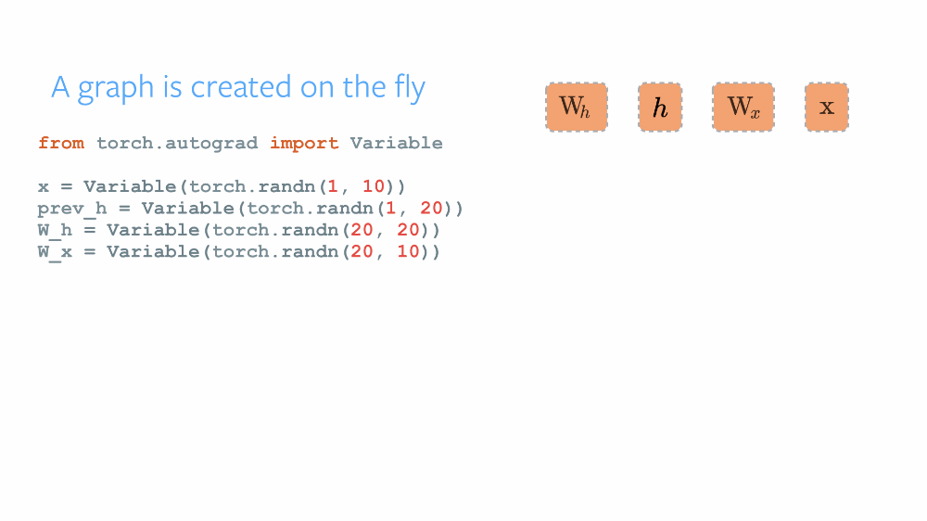
Autograd
Calling .backward() clears the current computation graph.
To retain the graph after the backward pass use loss.backward(retain_graph=True). This lets you reuse intermediate variables
Clear gradients each time with .zero_grad()
or they will overwrite previous gradients
Notes:
Conceptually, autograd maintains a graph that records all of the operations performed on variables as you execute your operations. This results in a directed acyclic graph whose leaves are the input variables and roots are the output variables. By tracing this graph from roots to leaves, you can automatically compute the gradients using the chain rule.
Internally, autograd represents this graph as a graph of Function objects (really expressions), which can be apply() ed to compute the result of evaluating the graph. When computing the forwards pass, autograd simultaneously performs the requested computations and builds up a graph representing the function that computes the gradient (the .grad_fn attribute of each Variable is an entry point into this graph). When the forwards pass is completed, we evaluate this graph in the backwards pass to compute the gradients.
An important thing to note is that the graph is recreated from scratch at every iteration, and this is exactly what allows for using arbitrary Python control flow statements, that can change the overall shape and size of the graph at every iteration. You don’t have to encode all possible paths before you launch the training - what you run is what you differentiate.

Slide 15
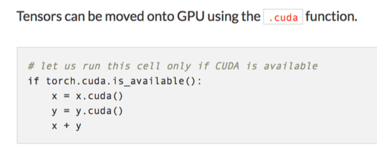
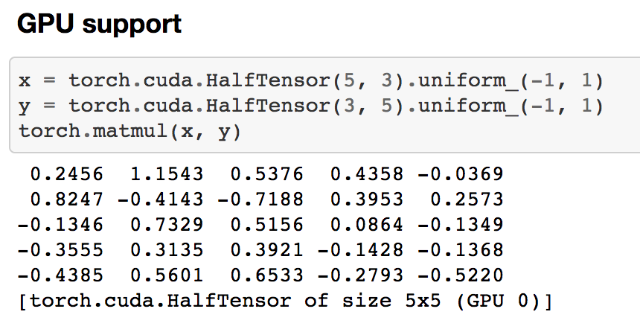
Running on GPU

Slide 16
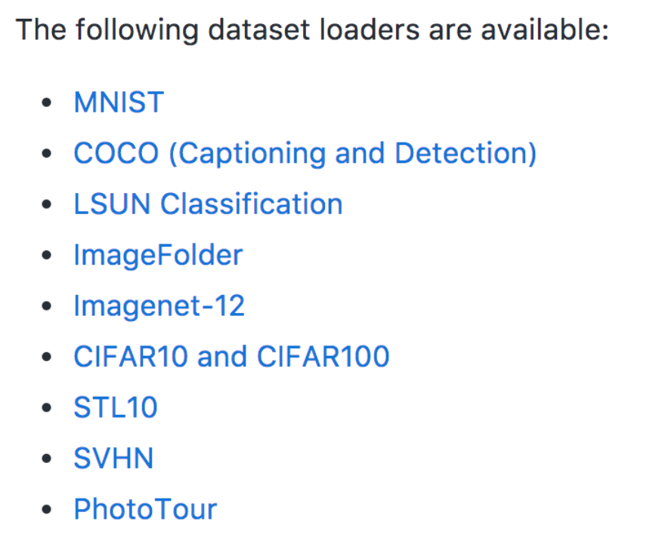
Loading Data
torch.utils.data.Dataset is an abstract class representing a dataset.
Your custom dataset should inherit Dataset and override the following methods:
__len__ so that len(dataset) returns the size of the dataset.
__getitem__ to support the indexing such that dataset[i] can be used to get iith sample

Slide 17
Subclassing nn.Module
class Net(nn.Module): def __init__(self): super(Net, self).__init__() # 1 input channel, 6 output channels, 5x5 convolution self.conv1 = nn.Conv2d(1, 6, 5) self.conv2 = nn.Conv2d(6, 16, 5) # an affine operation: y = Wx + b self.fc1 = nn.Linear(16 * 5 * 5, 120) self.fc2 = nn.Linear(120, 84) self.fc3 = nn.Linear(84, 10) def forward(self, x): # Max pooling over a (2, 2) window x = F.max_pool2d(F.relu(self.conv1(x)), (2, 2)) x = F.max_pool2d(F.relu(self.conv2(x)), 2) x = x.view(-1, self.num_flat_features(x)) x = F.relu(self.fc1(x)) x = F.relu(self.fc2(x)) x = self.fc3(x) return x def num_flat_features(self, x): size = x.size()[1:] # all dimensions except batch num_features = 1 for s in size: num_features *= s return num_features
Abstract class that defines methods needed to train neural network
Subclass nn.Module by overloading forward() and __init__() methods
Modules can also contain other Modules, allowing to nest them in a tree structure.

Slide 18
Multiprocessing
import torch.multiprocessing as mp from model import MyModel def train(model): # Construct data_loader, optimizer, etc. for data, labels in data_loader: optimizer.zero_grad() loss_fn(model(data), labels).backward() optimizer.step() # This updates shared parameters if __name__ == '__main__': num_processes = 4 model = MyModel() # NOTE: this is required for the ``fork`` method to work model.share_memory() processes = [] for rank in range(num_processes): p = mp.Process(target=train, args=(model,)) p.start() processes.append(p) for p in processes: p.join()
torch.multiprocessing is a drop in replacement for Python’s multiprocessing module.
It supports the exact same operations, but extends it, so that all tensors sent through a multiprocessing.Queue, will have their data moved into shared memory and will only send a handle to another process.

Slide 19
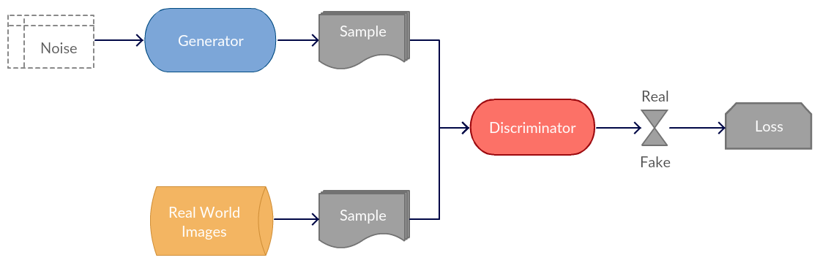
Generative Adversarial Networks
“Generative Adversarial Networks is the most interesting idea in the last ten years in machine learning.” – Yann Lecun, Director of Faceboook AI Research

Slide 20
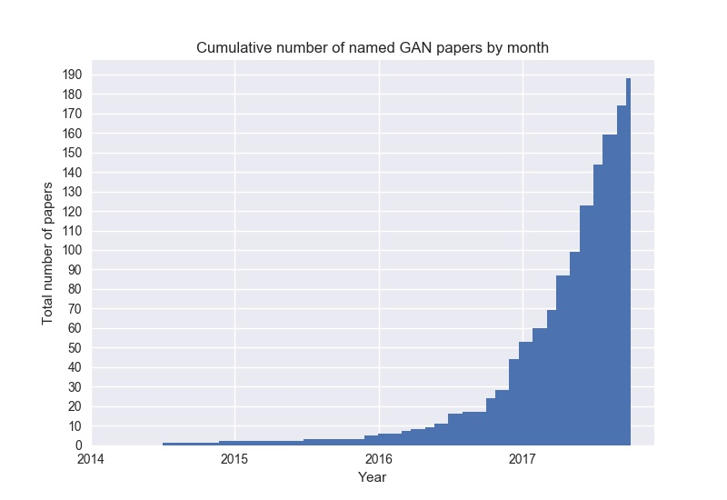

Slide 22
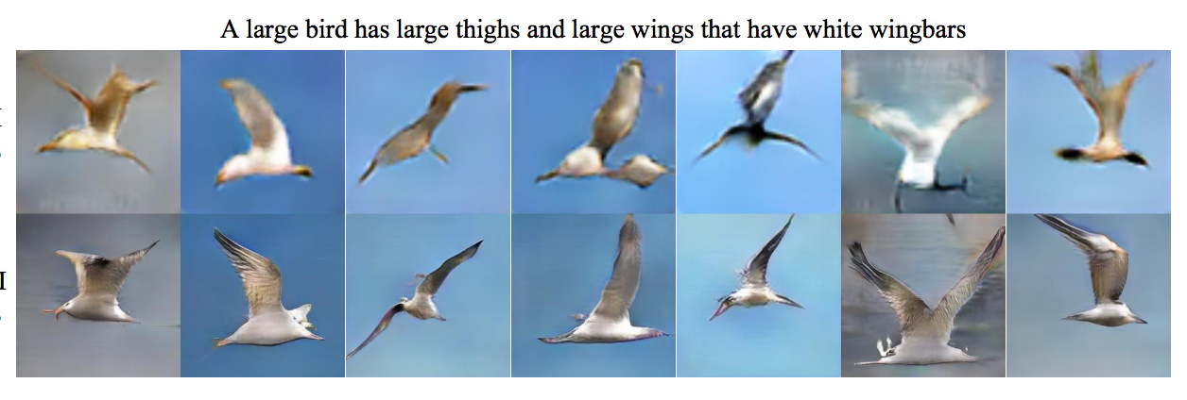
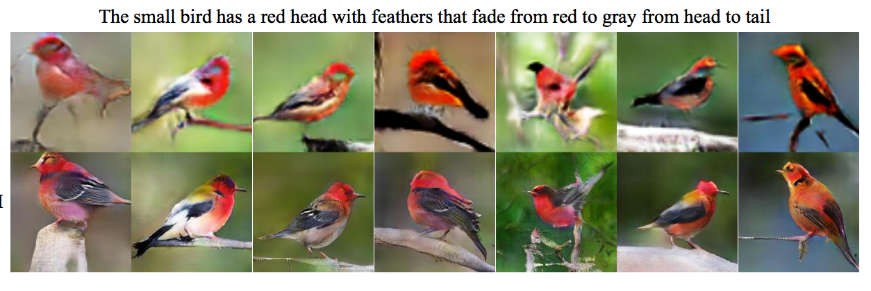
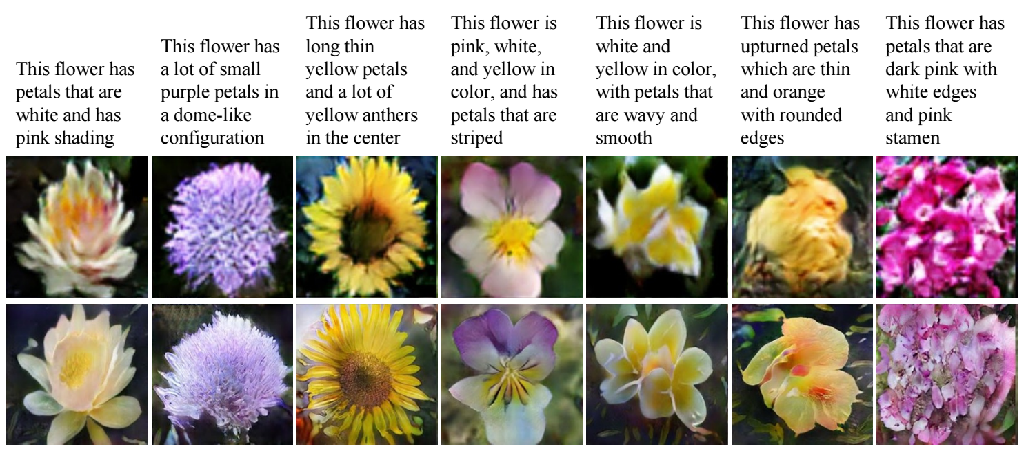
input
output
input
output
input
output

Slide 23
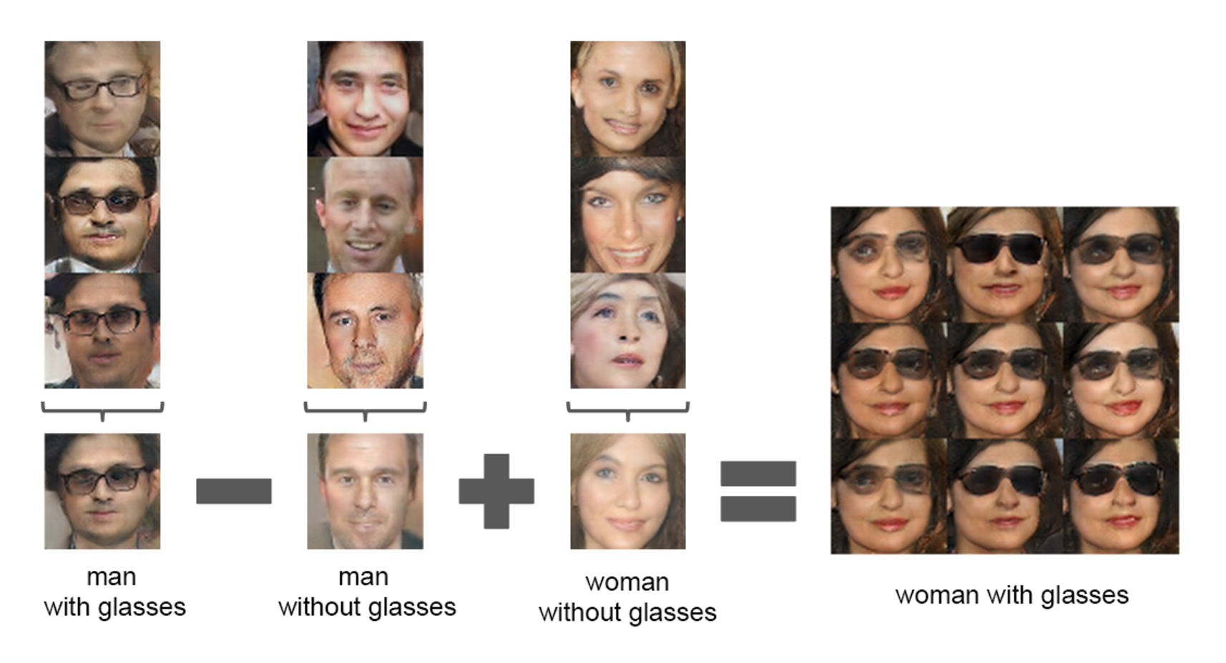
“Unsupervised Representation Learning with Deep Convolutional Generative Adversarial Networks”
Alec Radford, Luke Metz, Soumith Chintala
Notes:
algebra in latent space

Slide 24
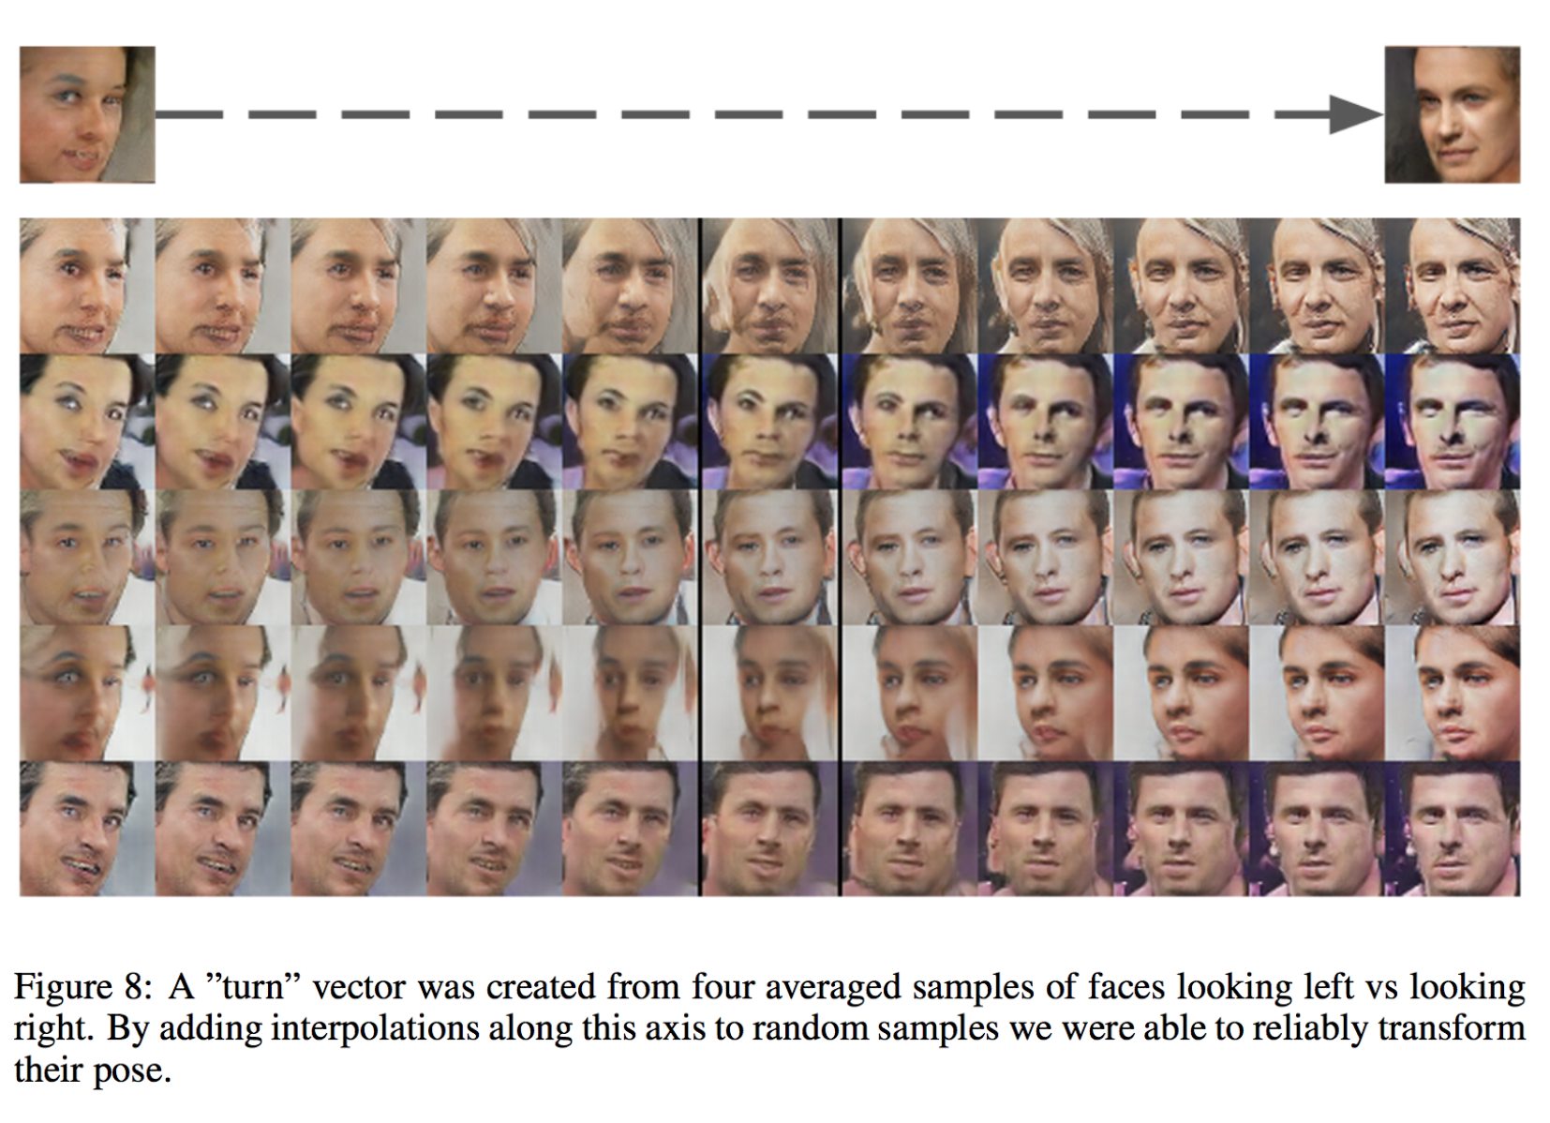
“Unsupervised Representation Learning with Deep Convolutional Generative Adversarial Networks”
Alec Radford, Luke Metz, Soumith Chintala

Slide 25
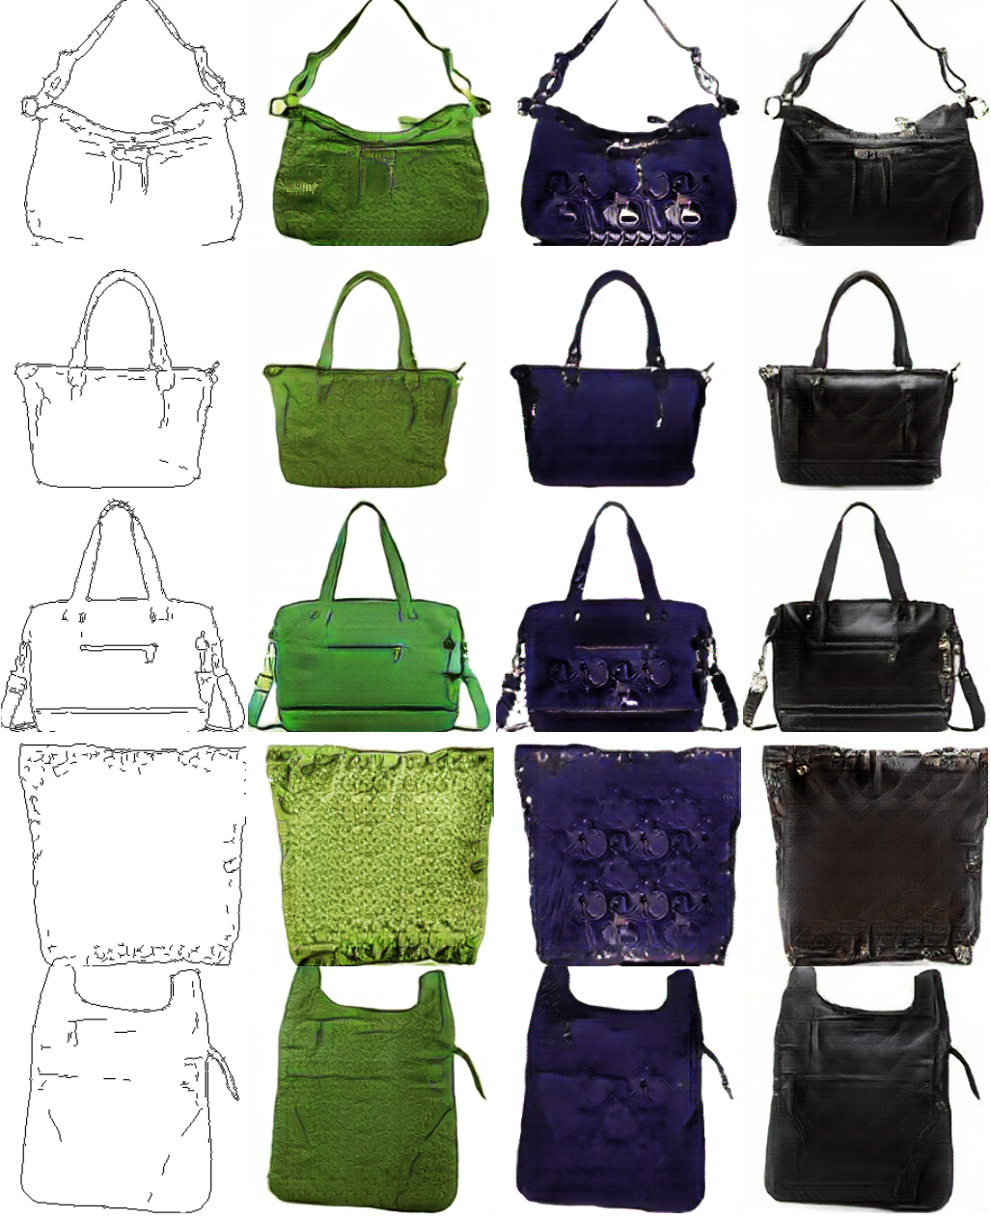
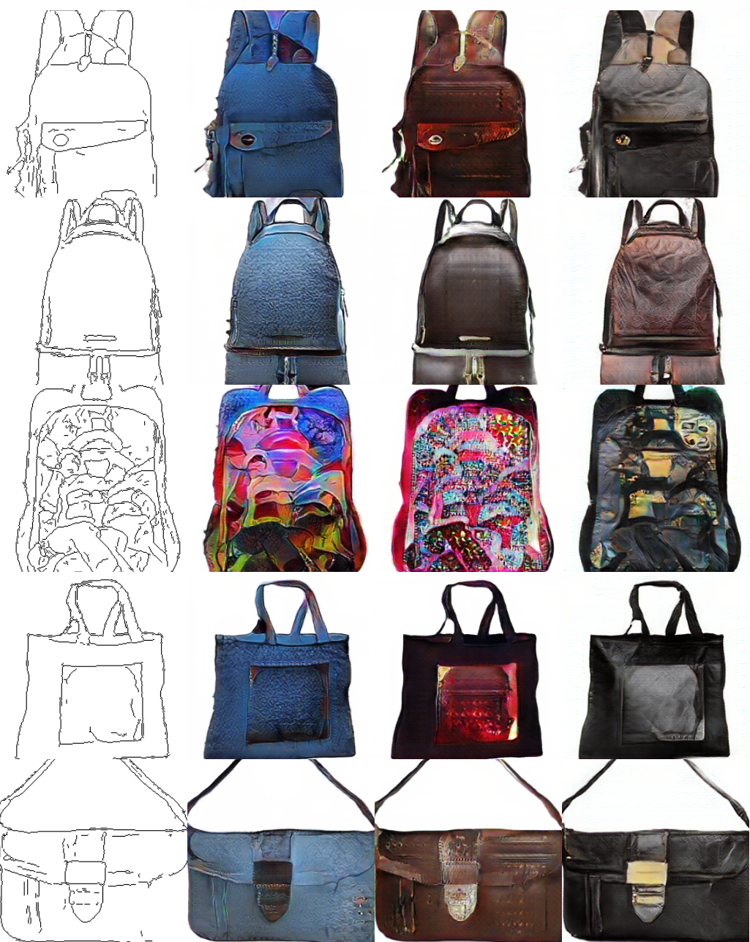
input
“Image-to-Image Translation with Conditional Adversarial Networks”
Phillip Isola, Jun-Yan Zhu, Tinghui Zhou, Alexei A. Efros
outputs
Notes:
Inverted edge detection.

Slide 26
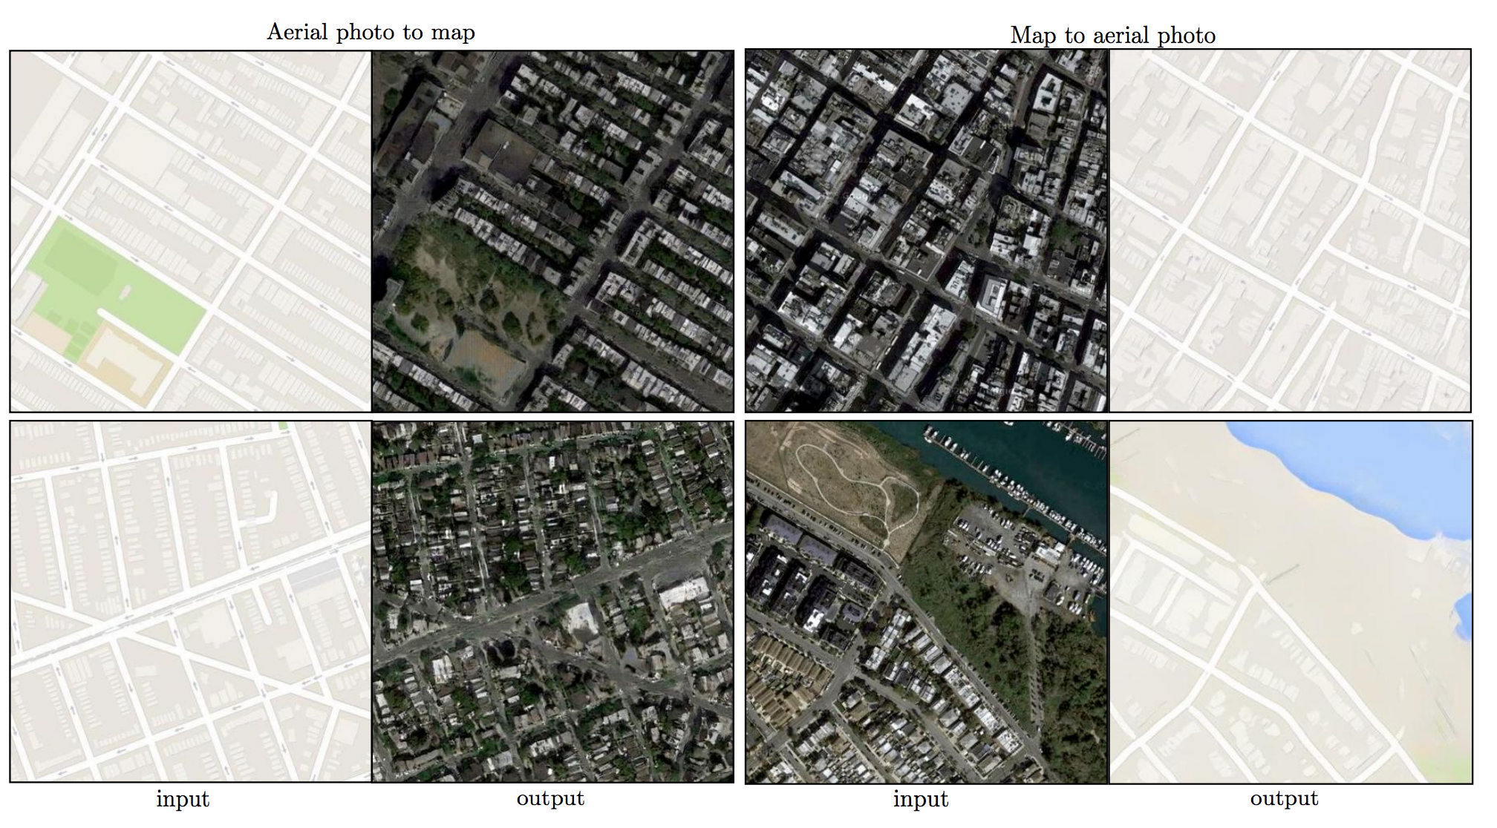
“Image-to-Image Translation with Conditional Adversarial Networks”
Phillip Isola, Jun-Yan Zhu, Tinghui Zhou, Alexei A. Efros

Slide 27
http://3dgan.csail.mit.edu/
https://www.youtube.com/watch?v=9reHvktowLY
http://carlvondrick.com/tinyvideo/

Slide 28
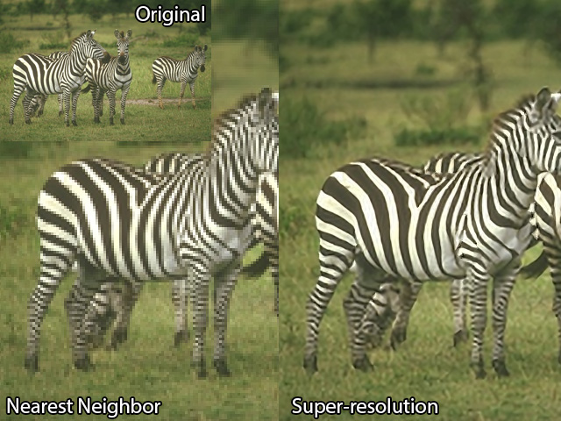
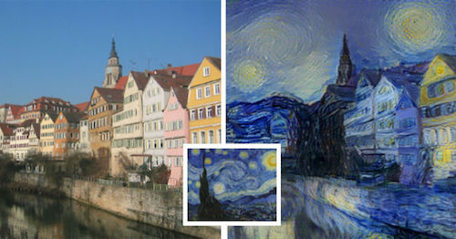
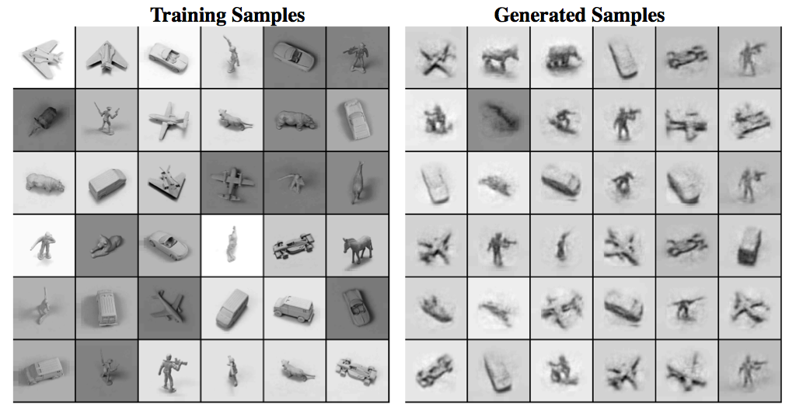
Generative Models
Simulate possible futures for planning in Reinforcement Learning
Missing data/ unlabeled data - semi-supervised/unsupervised learning
Multimodal outputs
Super resolution of single images

Slide 29
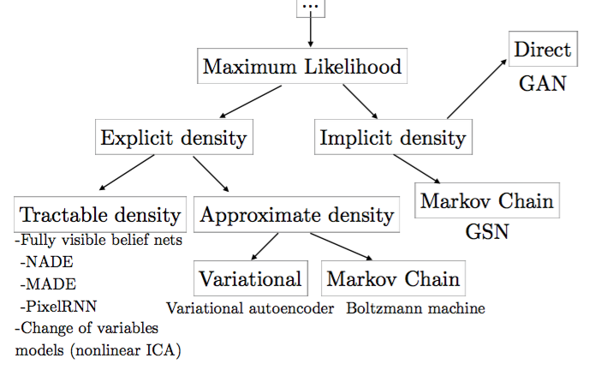
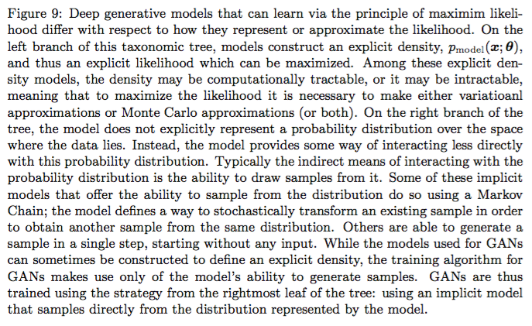
Types of Generative models
From Goodfellow’s Tutorial on GANs NIPS 2016
Notes:
PixelCNN is example of FVBN (Very slow because each pixel generated sequentially)
WaveNet is also very slow (2 minutes for 1 second of audio)
VAE have intractable density functions but use tractable approximations for density functions. Cannot marginalize out the latent variables so must approximate this with a variational bound. Tend to have lower quality samples despite high likelihood
GANs use a latent code, are asymtotically consistent, do not use Markov chains, and produce good quality samples

Slide 30
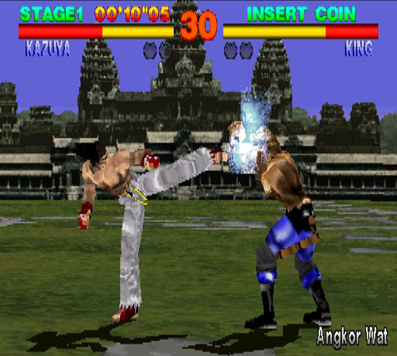
Epoch
Discriminator
Generator
D
G

Slide 31
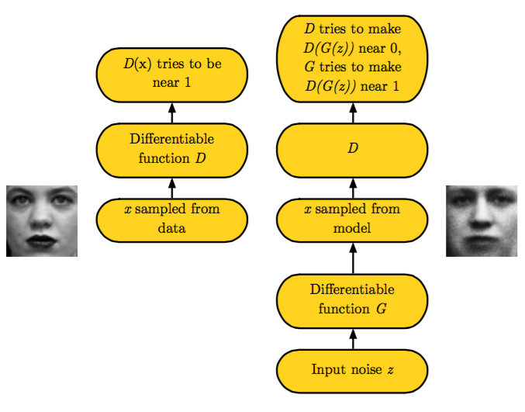
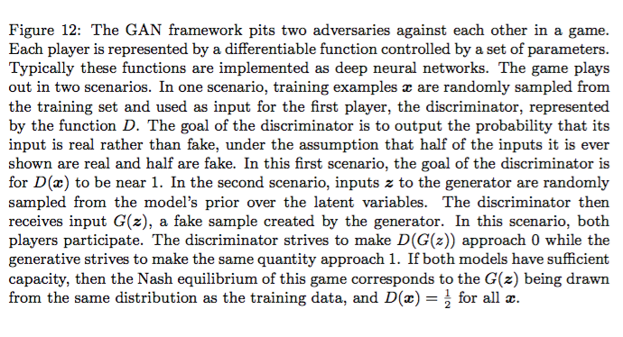

Slide 32
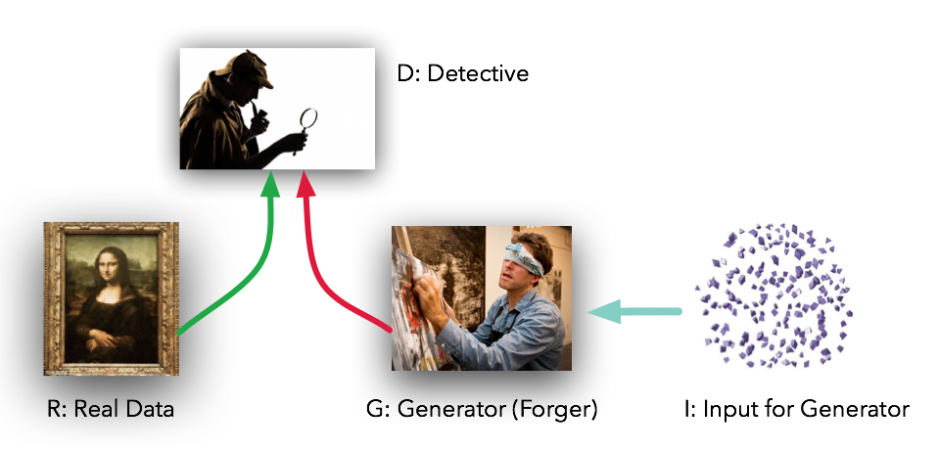
Notes:
Example Goodfellow uses is money Counterfeiters and police. Counterfeiters try to make realistic money and must make money that is realistic to real money but only know what if the police reject or accept the counterfeit money as real or not

Slide 33
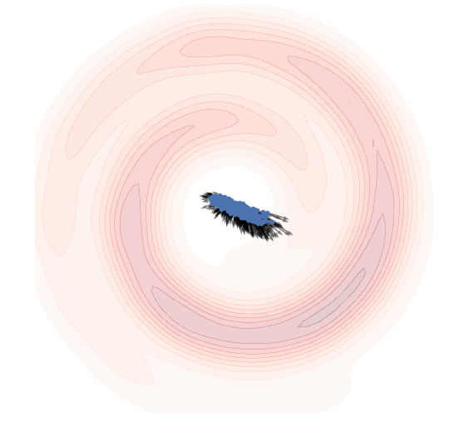
Game Theory
generative model minimising KL divergence from some Swiss-roll toy data
Goal is to find Nash Equilibrium of a non-convex game with continuous, high dimensional parameters
Equilibrium is saddle point of discriminator loss
Generator minimizes the log-probability of the discriminator being correct
Can represent as a two player zero-sum Minimax game
Resembles Jensen-Shannon divergence
http://www.inference.vc/an-alternative-update-rule-for-generative-adversarial-networks/
Notes:
player is assumed to know the equilibrium strategies of the other players, and no player has anything to gain by changing only his own strategy.^{[1]} If each player has chosen a strategy and no player can benefit by changing strategies while the other players keep theirs unchanged, then the current set of strategy choices and the corresponding payoffs constitutes a Nash equilibrium.

Slide 34
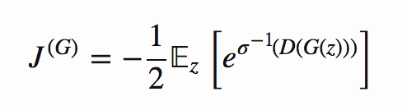
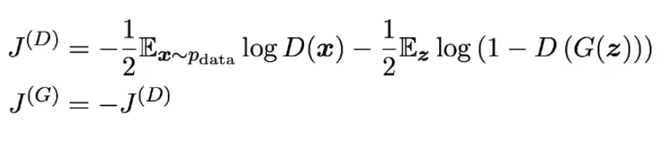
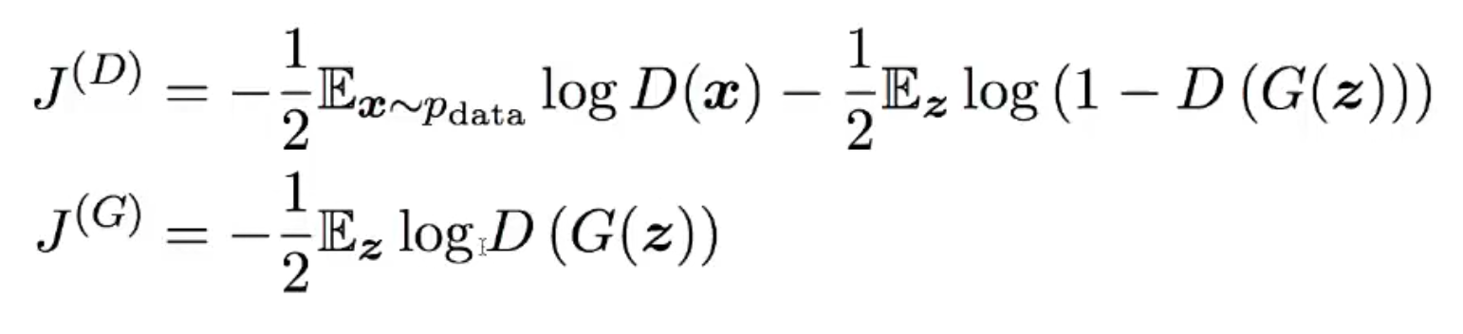
Losses
Maximum Likelihood version
Minimax version
Non-saturating version
Notes:
generator maximizes log-probability of discriminator being mistaken
generator can still learn even when discriminator rejects all generator samples

Slide 35
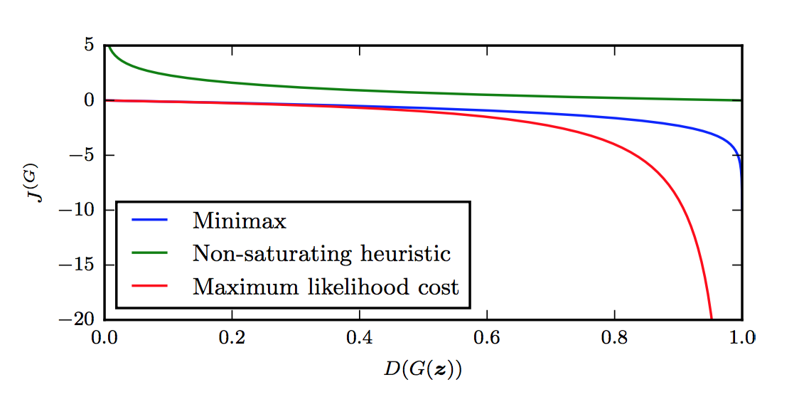
https://danieltakeshi.github.io/2017/03/05/understanding-generative-adversarial-networks/

Slide 36
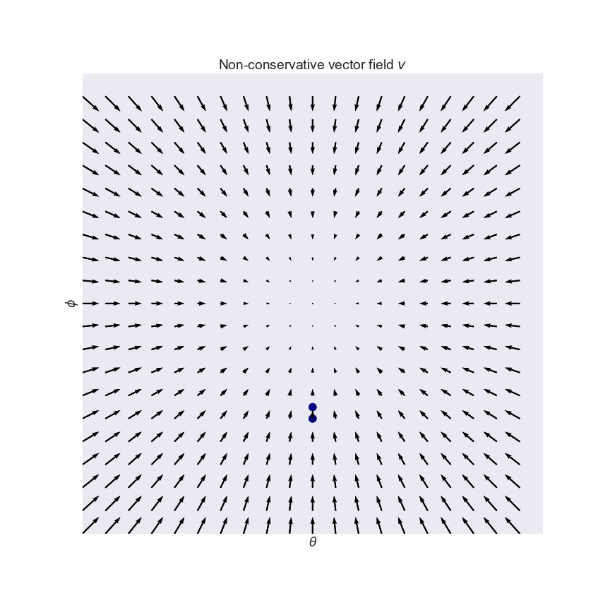
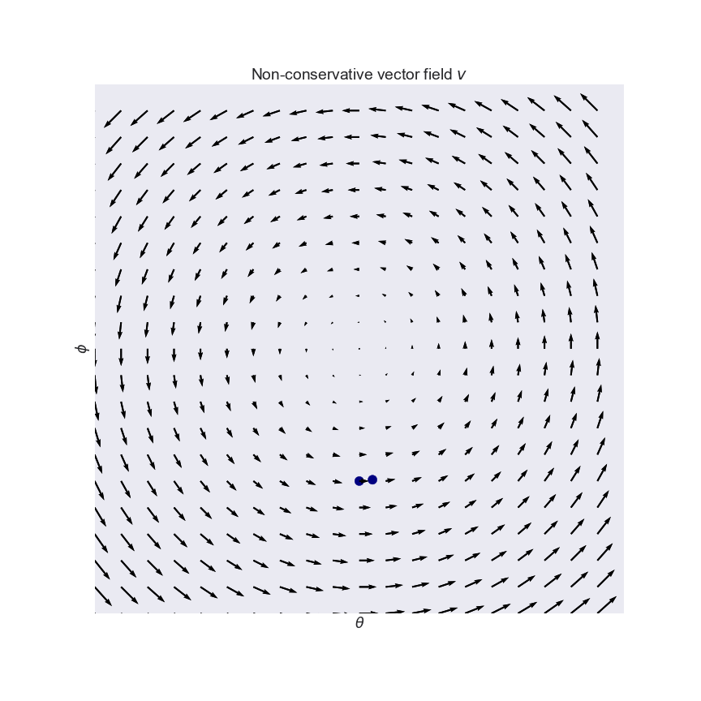
Simultaneous GD
Generalization of gradient descent
Non-convergence is biggest problem with GAN
May not approach saddle point because of non-conservative vector field
Can oscillate indefinitely (See figure)
Mode collapse is worst form of non-convergence (generates same version of example; doesn’t generate diverse sample set)
http://www.inference.vc/my-notes-on-the-numerics-of-gans/
https://arxiv.org/abs/1705.10461
Notes:
Conservative vector fields have the property that the line integral is path independent, i.e., the choice of any path between two points does not change the value of the line integral. Path independence of the line integral is equivalent to the vector field being conservative. A conservative vector field is also irrotational; in three dimensions, this means that it has vanishing curl. An irrotational vector field is necessarily conservative provided that the domain is simply connected.

Slide 37
Directions of research
How to stabilize training and prevent mode collapse? Wasserstein loss, F-GAN
How to evaluate GAN performance? (General problem to generative models)
How to use discrete outputs with GAN? Sequences of characters and words
Supervised Discriminator for semi-supervised learning. Have multiple classes instead of just real and fake. Odena 2016, Salimans et al 2016
Connections to RL. “GANs as actor-critic” Pfau and Vinyals 2016. “GANs as inverse reinforcement” Finn et al 2016. “GANs for imitation learning” Ho and Ermon 2016
“Bayesian GANs” Saatci and Wilson 2017.

Slide 38
GAN hacks
https://github.com/soumith/ganhacks
Normalize inputs
Sample noise from gaussian instead of uniform
Use Batchnorm
Avoid sparse gradients:ReLU, MaxPool
Use SGD for D and ADAM optimizer for G
Use Label smoothing and occasionally flip labels when training D
Use Dropout in G in both train and test
Notes:
Conservative vector fields have the property that the line integral is path independent, i.e., the choice of any path between two points does not change the value of the line integral. Path independence of the line integral is equivalent to the vector field being conservative. A conservative vector field is also irrotational; in three dimensions, this means that it has vanishing curl. An irrotational vector field is necessarily conservative provided that the domain is simply connected.

Slide 39
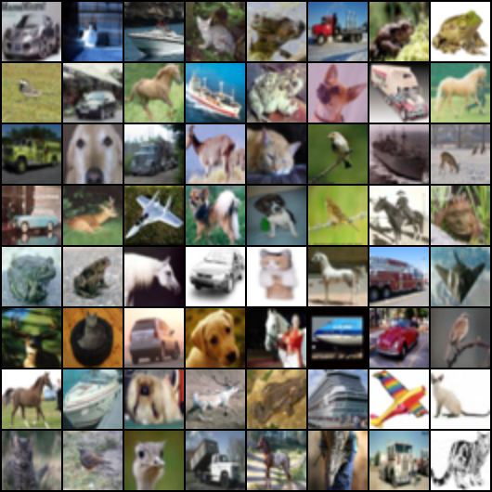
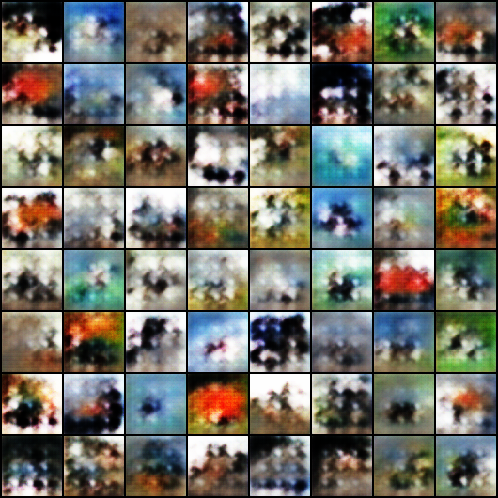
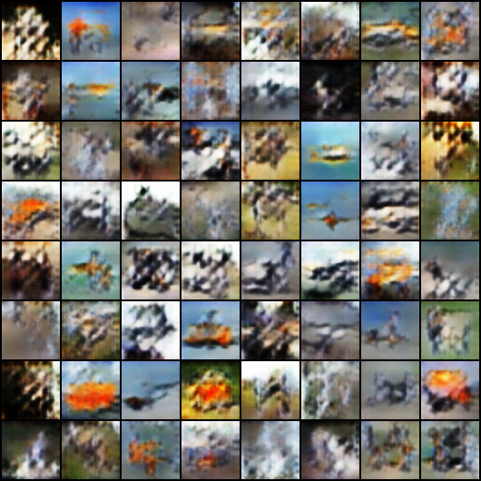
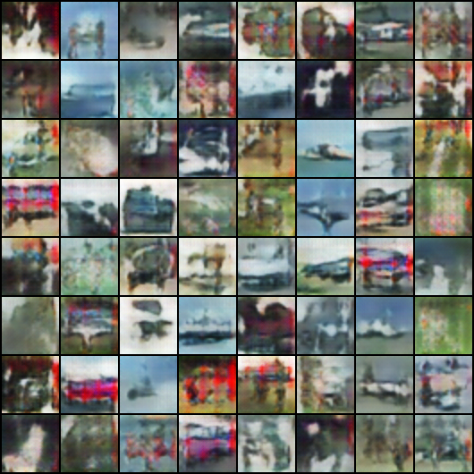
DCGAN in PyTorch
https://github.com/pytorch/examples/blob/master/dcgan/main.py

Slide 40
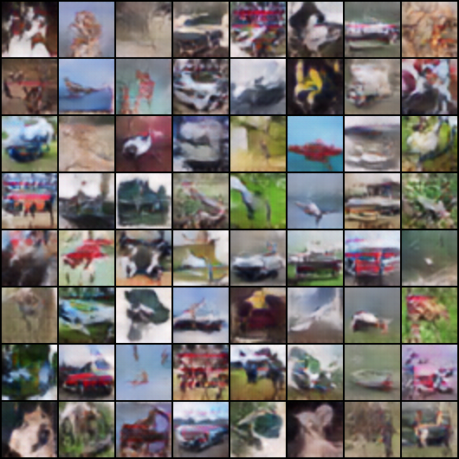

Slide 41
